Slide 1



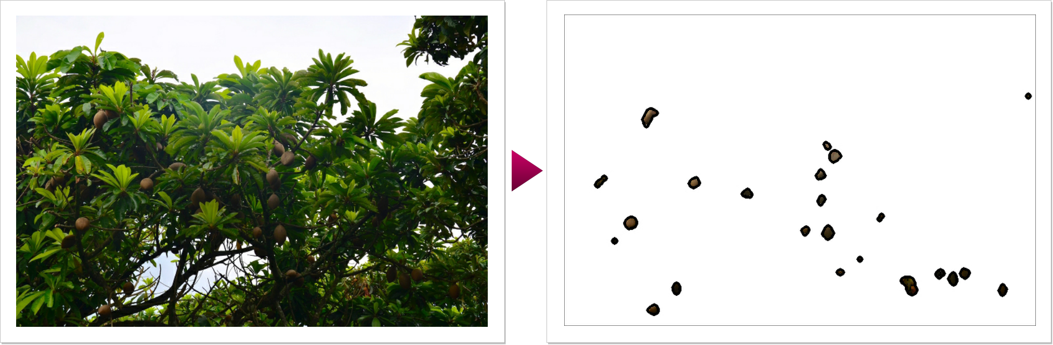
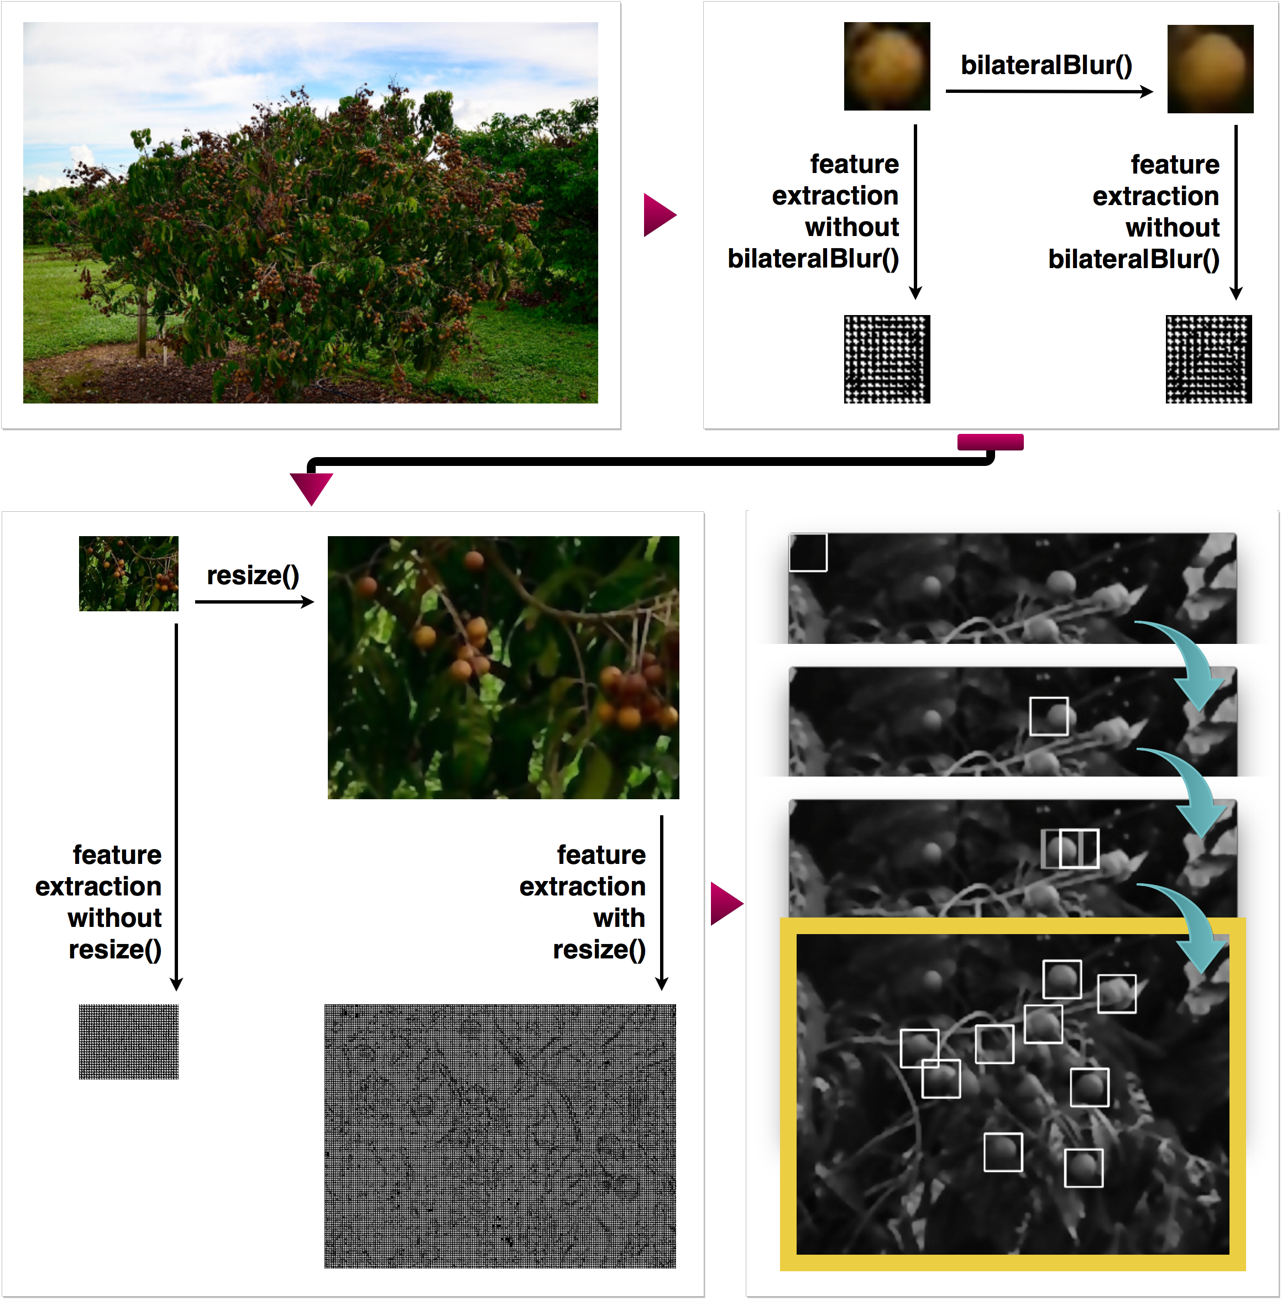
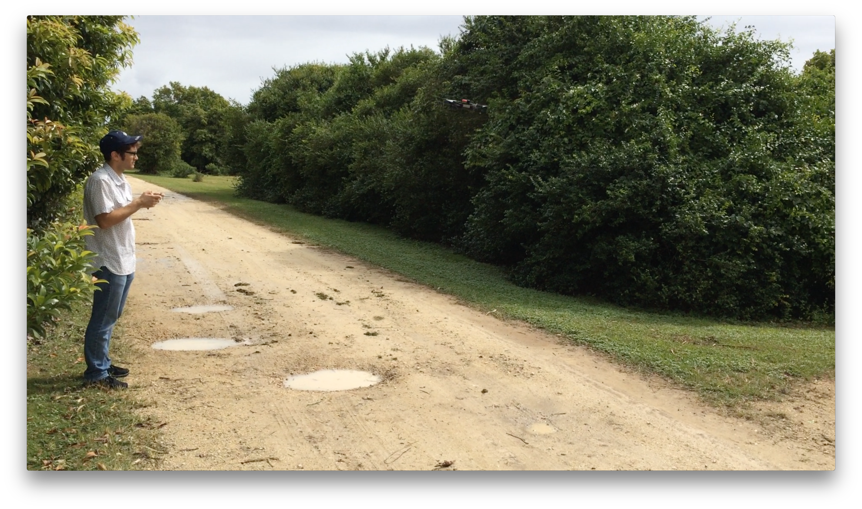
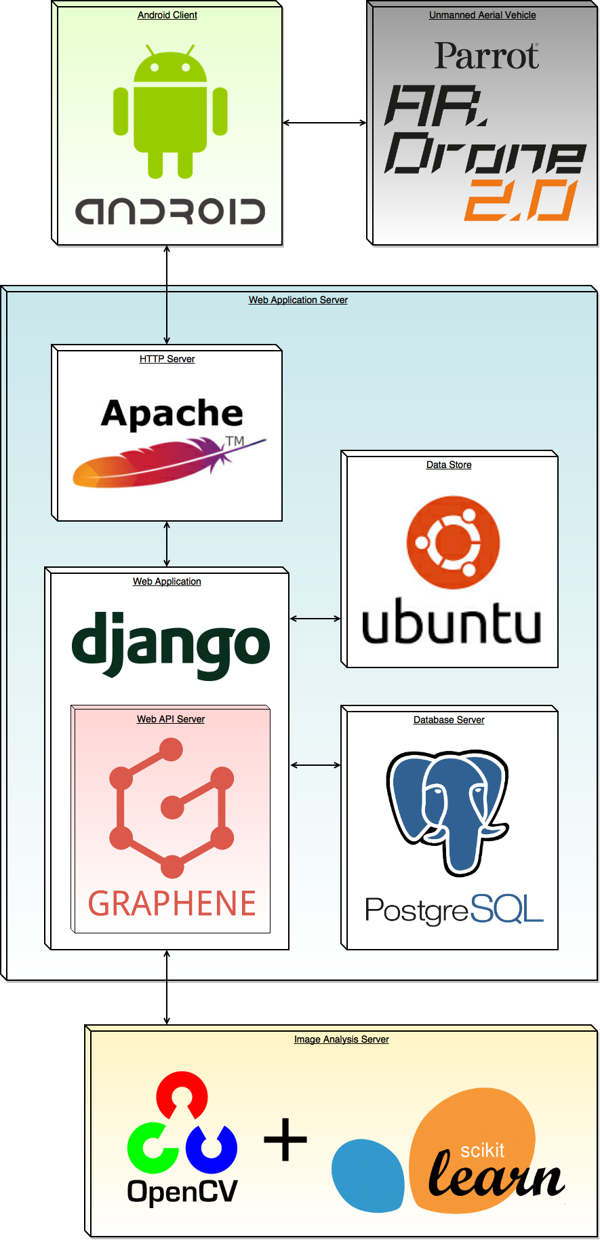
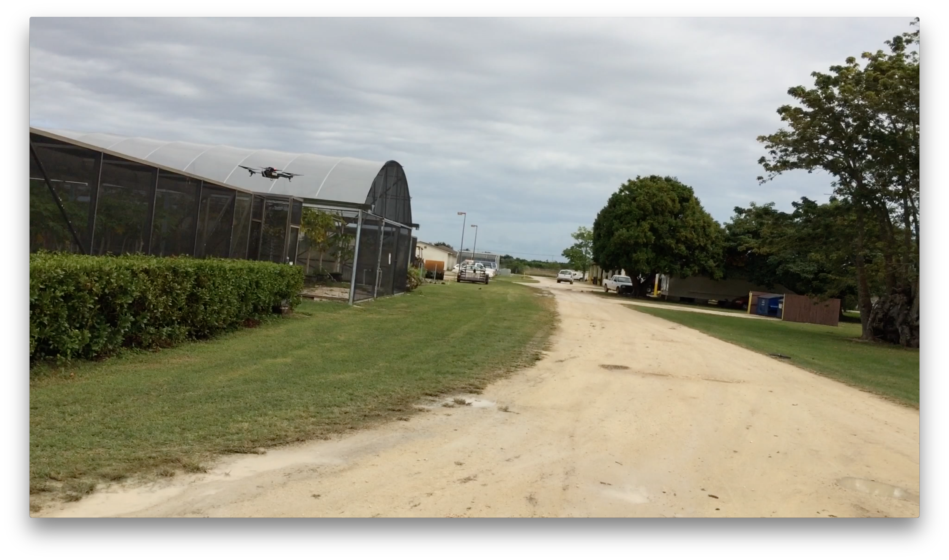
FruiTREC v1.0
An Agricultural Robotics Application
Senior Project — 2016, Fall
Student: Franklin Abodo¹
Mentors: Dr. Wagner Vendrame², Dr. Leonardo Bobadilla¹
Instructors: Mohsen Taheri¹, Dr. Masoud Sadjadi¹
¹School of Computing and Information Sciences, Florida International University, Miami, FL 33199
²Tropical Research and Education Center, University of Florida, Homestead, FL 33031
Motivation
Image Analysis Subsystem Implementation
Crops used in agricultural research experiments today must be short and cover a small area.
One reason is because researchers must measure horticultural characteristics (HCs) by hand.
Crops may be too tall for humans to safely collect, or too broad for humans to conveniently collect, HC data.
Unmanned Aerial Vehicles (drones) can:
Increase coverage of crops that span large areas
Eliminate the risk of a person falling
Computer Vision (CV) tools can:
Automate the analysis of HC data
Brown Sapote Fruit Detector
Detection based on color segmentation can be used on brown sapote because:
It differs substantially in color from surrounding leaves
Mature trees are tall enough that the drone can see the entire canopy, but not the ground.
Requirements
Longan Fruit Detector
The FruiTREC project requires the development of:
A mobile front-end that lets users plan and execute drone missions, and generate reports on collected HC data.
A CV module that extracts meaningful HC information from raw sensor data.
A website to allow additional users to access data visualizations on computers with large screens.
A back-end web application that interfaces the web and mobile clients, and the CV module and database.
System Design & Implementation
Acknowledgements
We train a supervised machine learning algorithm to detect longan based on their shape.
Detection based on image texture is used on longan because:
Its tree is too short to avoid observing the similarly colored ground.
Its round shape is easily distinguishable from surrounding leaves.
The algorithm combines a Histogram of Oriented Gradients (HOG) image feature descriptor, and a Support Vector Machine (SVM) linear classifier.
The material presented in this poster is based on work supported by the Motion, Robotics and Automation Lab at FIU, and the Tropical Research and Education Center at UF. Our object detector is derived from an open-source implementation written by Bikramjot Hanzra. HOG was invented by Navneet Dalal and Bill Triggs. SVM was invented by Vladimir Vapnik and Alexey Chervonenkis.
Notes:
‹#›

